Slide 1
Project 1:
Exploring climate data of Singapore in relation to Traffic Accidents

Slide 2
Contents
Problem Statement
Data Used
Initial Findings
Findings
Caveats
Conclusion and Recommendations

Slide 3
Problem Statement
It was reported in 2013 that more accidents occur on days of thunderstorms. Traffic accidents cause road congestion and Traffic Police and Civil Defence resources need to be deployed.
By using climate information on rainfall and traffic accident statistics, this project aims to help Traffic Police and Civil Defence better facilitate manpower and resource allocation throughout the year by identifying trends between traffic accidents and weather.

Slide 4
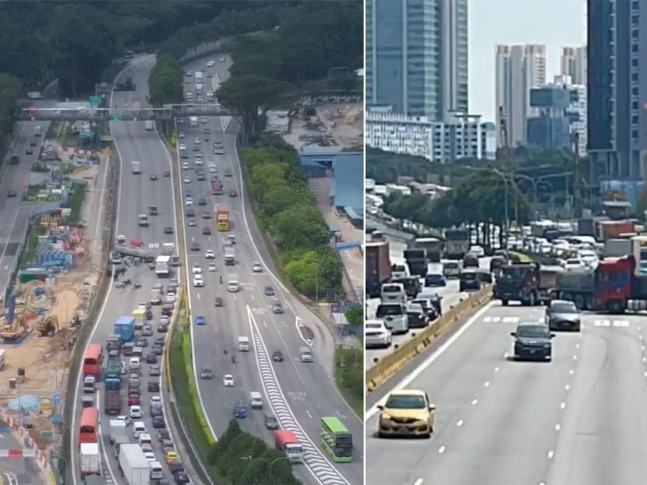
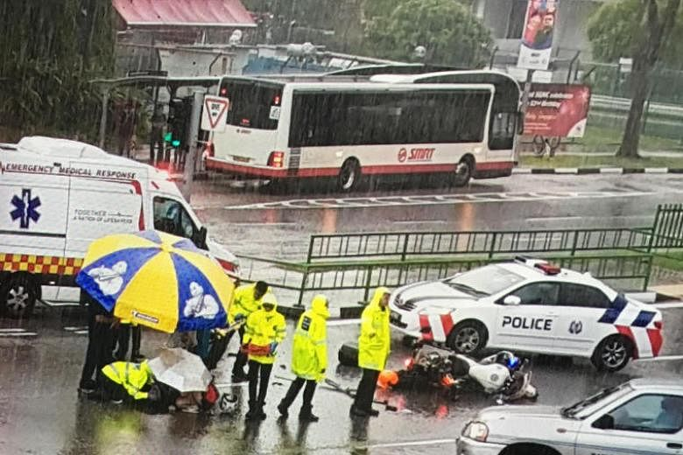
The Actual Problem
Image source: https://www.todayonline.com/singapore/accident-involving-trailer-and-car-pie-causes-traffic-gridlock-around-noon-oct-26
Image source: https://www.straitstimes.com/singapore/transport/car-crashes-into-scdf-officer-on-his-way-to-medical-emergency-officer-injured

Slide 5
Data Used
Monthly total rain recorded in mm(millimeters) from 1982 to 2022.
Monthly number of rain days from 1982 to 2022. A day is considered to have “rained” if the total rainfall for that day is 0.2mm or more.
The monthly mean sunshine hours in a day recorded at the Changi Climate Station from 1982 to 2022.
The highest daily total rainfall for the month recorded at the Changi Climate Station recorded in mm(millimeters) from 1982 to 2022.

Slide 6
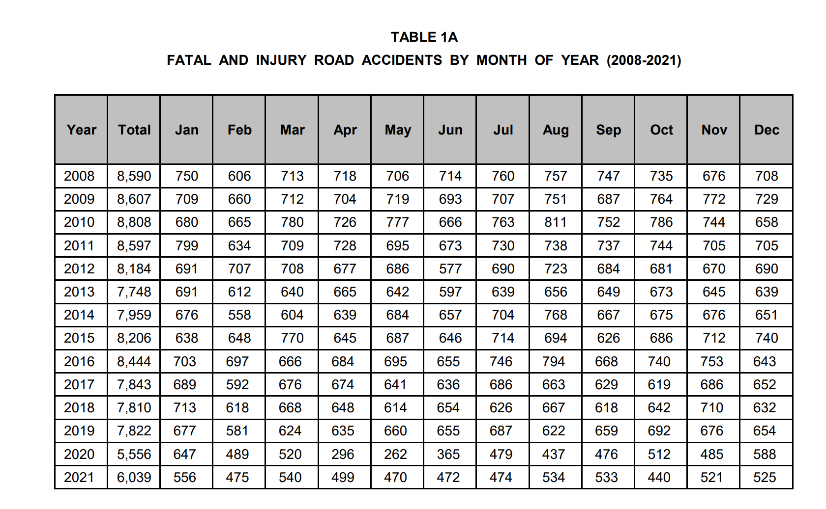
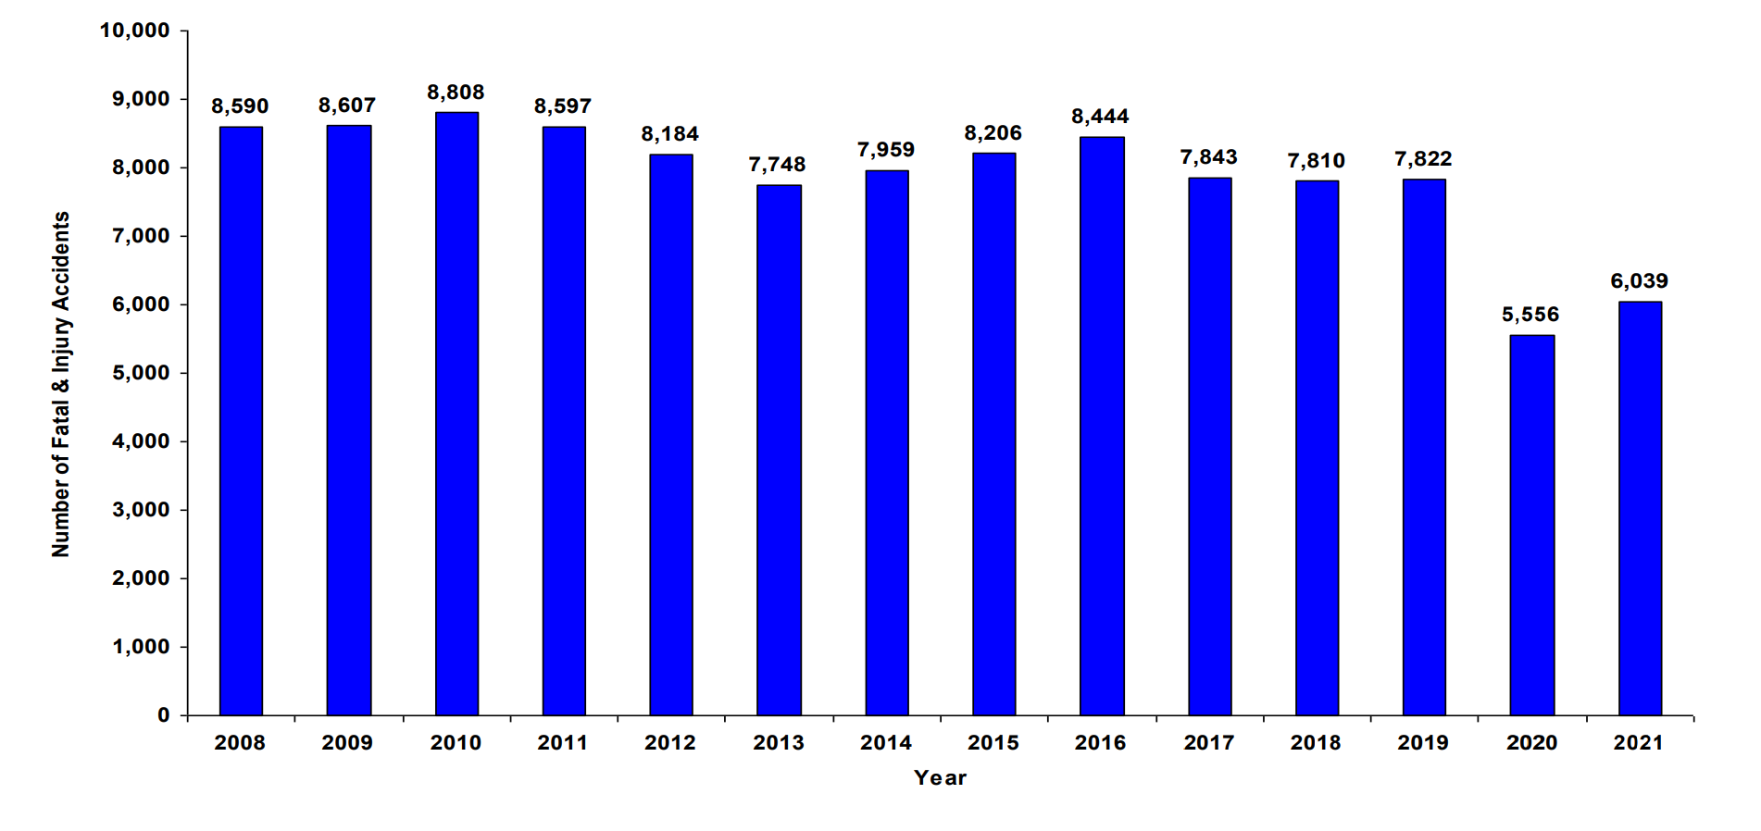
Traffic Accidents (2008 to 2021)
Source:
https://www.police.gov.sg/-/media/1F7F9460FD8F48928B6DEFE096414975.ashx

Slide 7
Initial Findings
There were no significant patterns or correlations when matching each metric with Traffic Accident statistics at first glance.
It was noted that the data for Accident Statistics was significantly lower in 2020 and 2021.
It was noted that 2020 and 2021 were covid lockdown years.

Slide 8
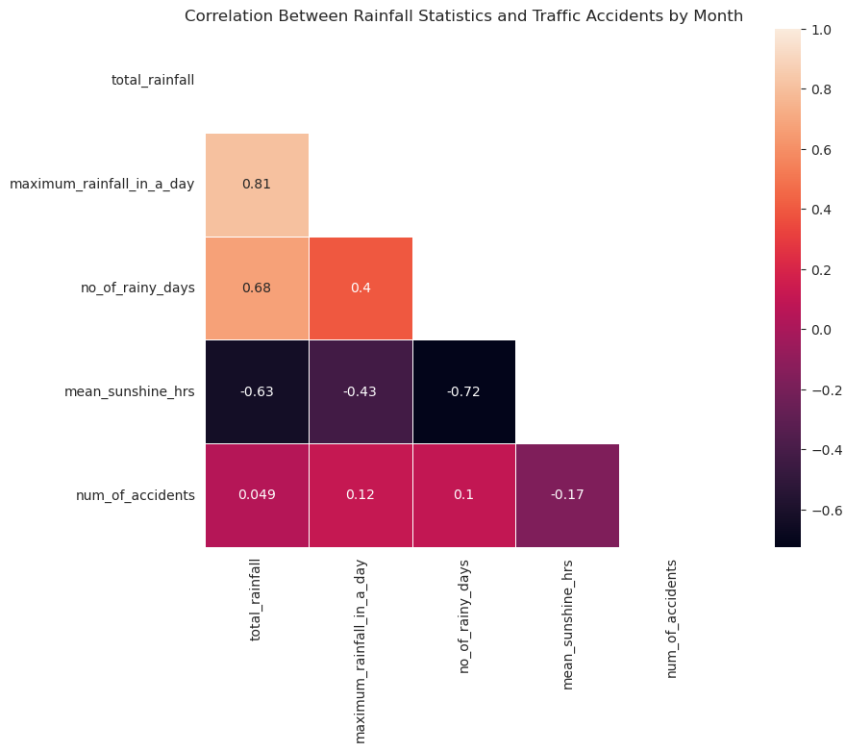
Findings

Slide 9
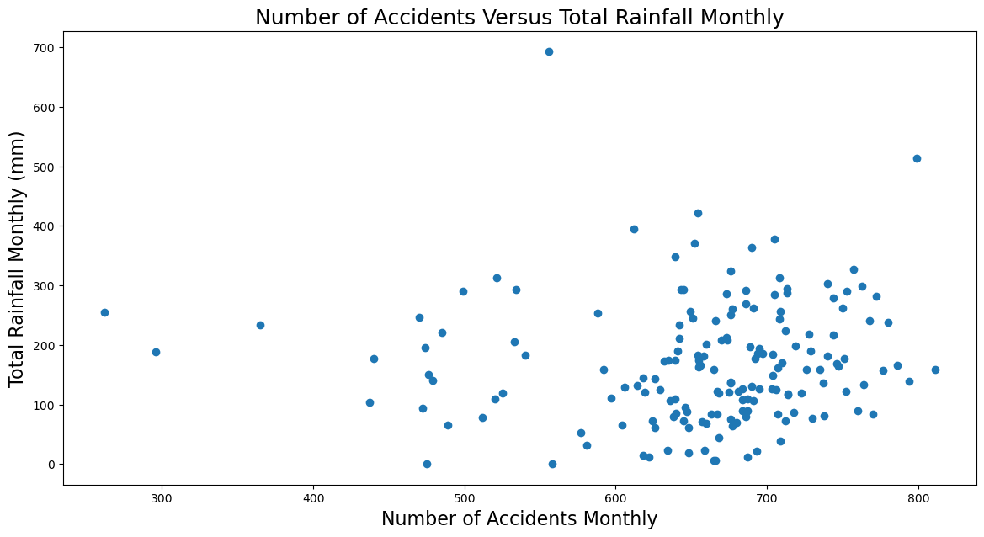
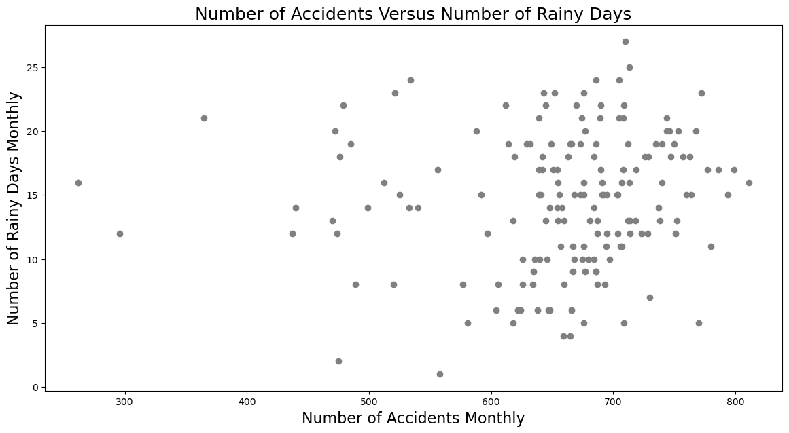
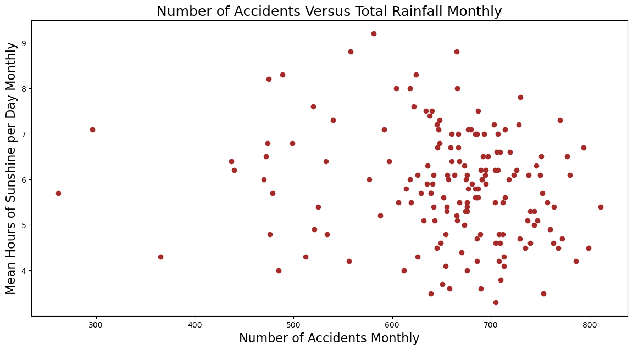
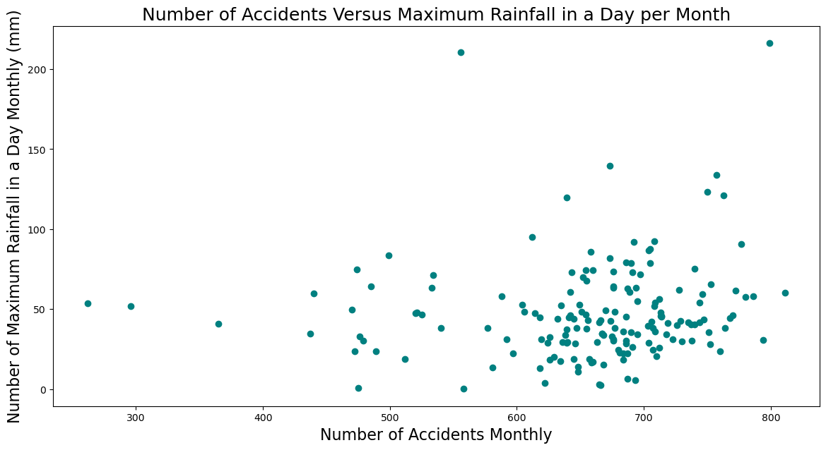
Findings (cont’d)

Slide 10
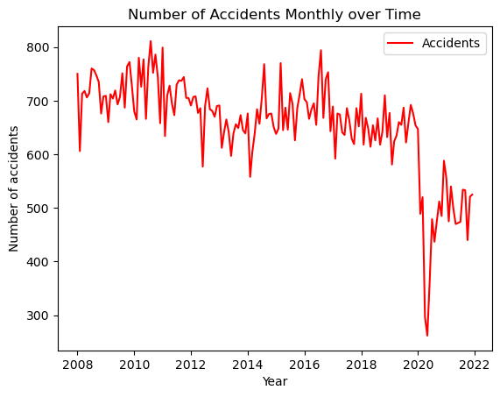
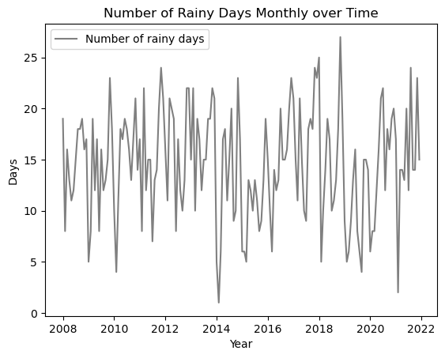
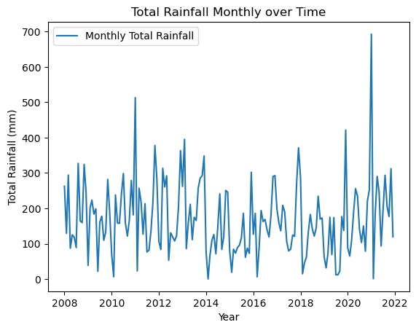
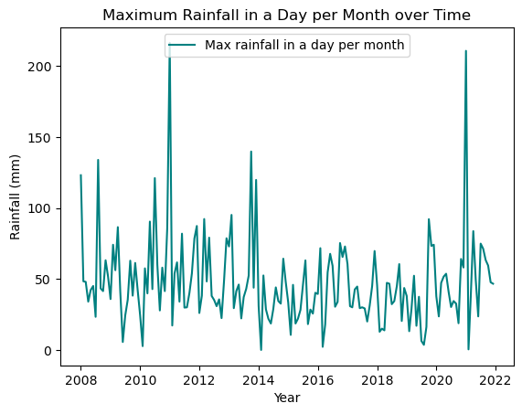
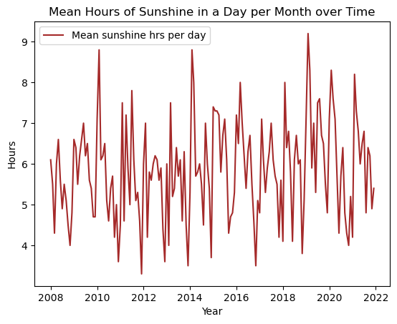
Findings (cont’d)
Compare shape of this line with all the others.

Slide 11
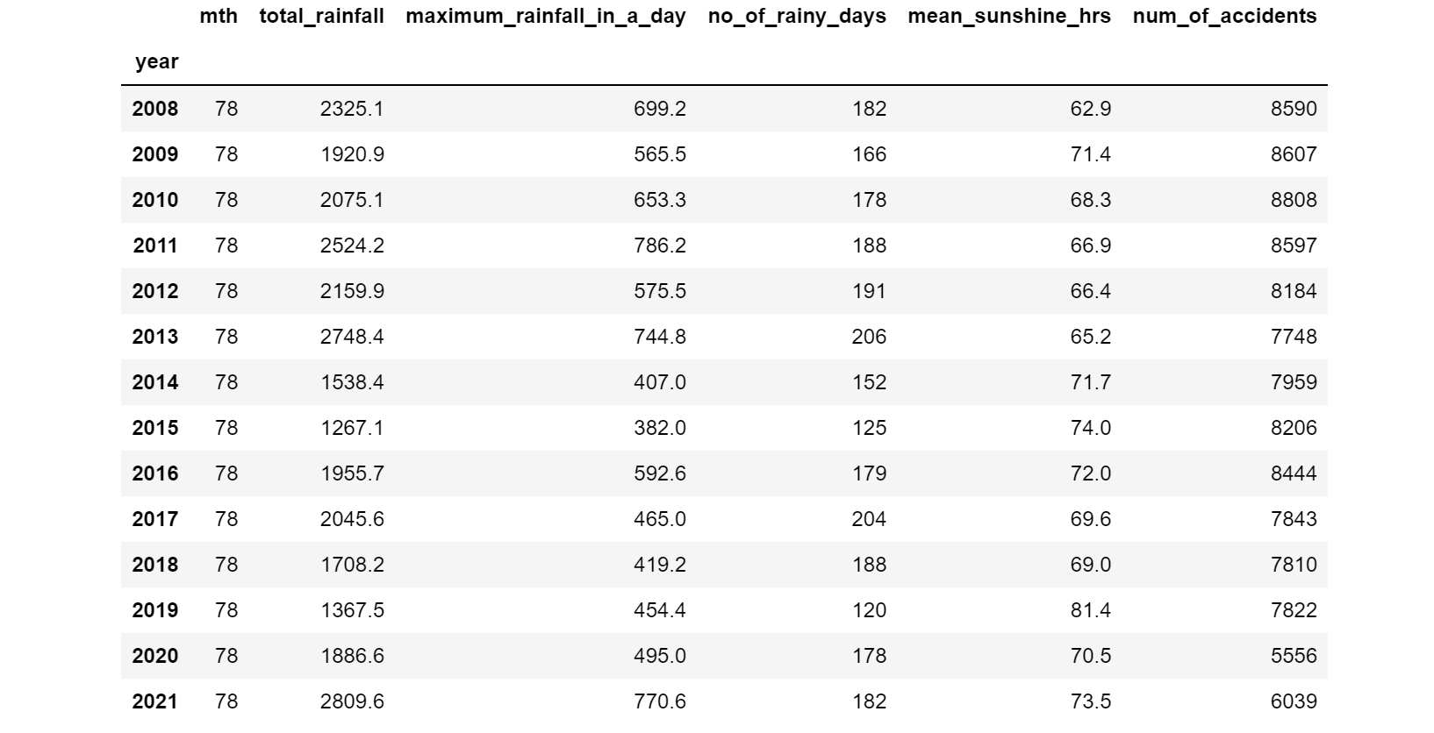
Findings (cont’d)

Slide 12
Findings
All graphs seem to reaffirm what was found in the initial findings. That the weather data as it is, does not show any meaningful correlation or trends when compared with accident statistics.
Perhaps what can be explored in future studies as shown in the heat map could be data on weather conditions that affect visibility (e.g no. of days with thunderstorms or intense rainfall)
Significantly less traffic accidents in 2020 and 2021 would suggest that road usage is a bigger factor than weather in affecting the occurrence of traffic accidents.

Slide 13
Caveats
The data used was limited as it only takes into account weather statistics taken from Changi climate station.
Traffic statistics are skewed by the inclusion of data from 2020 and 2021.
Other factors that might affect traffic accidents even during averse weather conditions may not have been factored in.

Slide 14
Conclusion and Recommendations
Conclusion: Given the lack of a correlation or clear pattern when comparing weather statistics against traffic accident data, we can conclude that weather on its own is not a significant reason for traffic accidents in Singapore.
Recommendations: I would recommend maintaining the status quo in terms of resource allocation during months with high rainfall numbers.
I would also recommend that another project designed to be more robust be explored using the following data, together with the existing weather data when determining how to properly allocate manpower and resources.
Obtain weather data from other parts of Singapore and compare them to the corresponding accident statistics in that area.
Due to the drastic fall in number of accidents in 2020 and 2021, I would suggest looking at the correlation between road usage and traffic accidents.
A quick Google search online will yield many articles suggesting that visibility is a factor in the number of accidents. I would suggest obtaining weather data specifically looking at months with stormy weather and intense rainfall against traffic accident statistics.
Based on the 2020 and 2021 statistics, I would recommend that instead of allocating additional resources to Traffic Police and Civil Defence during the rainy season, resources should be directed to reducing road usage in general in order to bring down the number traffic accidents.

